Slide 1
Via Overview
March 18, 2015
Connecticut Oncology Society

Slide 2
Introduction
Ed Rodgers
Director of Network Development
Thank you for the opportunity to talk today!

Slide 3
Who are we?
Via Oncology is a clinical pathways company focused exclusively on all things cancer
Started in 2009 - Today over 1150 cancer providers from 28 practices in 19 states
4 Academic Centers
10 Hospital Based Programs
14 Community Based Programs
11 are Aetna OPCMH Project Sites

Slide 4
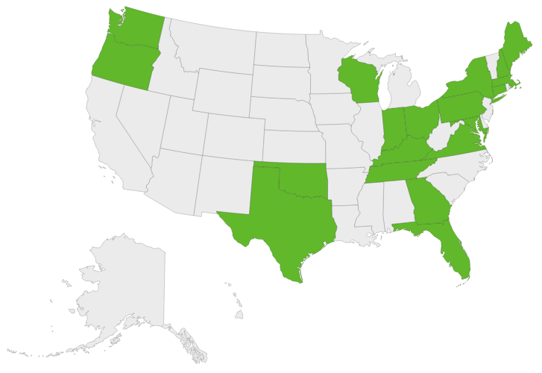
Via Network

Slide 5
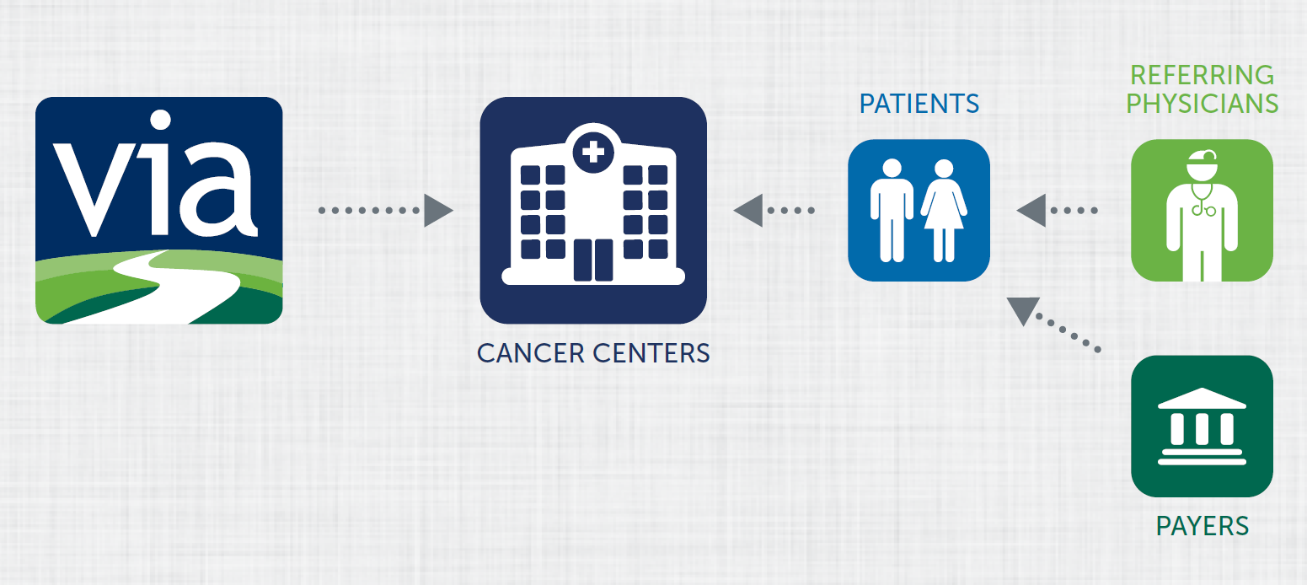
Via’s Business Model

Slide 6
Agenda
Overview of the Aetna project and use of the Via Pathways
Support for CMMI OCM and other P4P initiatives
High Level Via Pathways development and maintenance process/philosophy
Demo of Via Portal
Discuss implementation / operations process
Review of Reporting

Slide 7
Aetna Process and Timing
Initial Via Pathways presentation and demo
Execute non-disclosure agreement with Via
Via to email you:
Copies of current Breast, Colon and Lung pathways
Draft contract with Via for Aetna Limited Implementation Model
Practice signs contract with Aetna
Practice to select a pathways vendor
If selecting Via:
Sign contract with Via
Work with Via on set-up and training
Proposed Go Live dates follow Aetna preference/availability, typically 1-3 months

Slide 8
Aetna OPCMH Project
Only needs a limited implementation of the Via Pathways
No interfaces required
Only Aetna members (certain Aetna plans are excluded)
Only breast, colon and lung
Only treatment decisions
Via Portal can be used by non-physician staff for input
Daily emails sent by Via to designated practice staff re: decision details
Via sends a file weekly to Aetna with member names/plan id
Aetna matches to their systems to:
Register patients in the pilot
Alert practices when patients are hospitalized
Target On Pathway Rate has not yet been established
Likely to be lower than 80% initially

Slide 9
Aetna Program Automation
Every week Via batch transmits all decisions to Aetna in a secure email
This allow Aetna to “enroll” the patients into their ED/Hospitalization notification system
We send all decisions in Aetna project to each customer contact daily (so they have an opportunity to QA the treatment selections prior to the batch sending to Aetna)
We have developed and implemented the automation of sending copies of the TP and TS to Aetna on a quarterly basis,
Alleviates the need for practices to fax/scan each one individually
Aetna pays 4 S-codes for advanced reimbursement
We provide quarterly reports back to the practices to let them reconcile charge capture for these S-Codes
Or as a primary point for submitting S-Codes
4 S-Codes reports identify patients in these categories:
Advance Care Planning discussion
Treatment Plan creation
Treatment Summary creation
Oral Drug Monitoring

Slide 10
Support for CMMI OCM and other P4P initiatives

Slide 11
CMMI OCM Background
CMS/CMMI announced a voluntary payment model program for oncology dubbed the “Oncology Care Model”
A five year program that includes a PMPM care management fee of $160 and the ability to achieve gain share if overall savings are greater than 4% of CMS’ target spending for total cost of care.
Practices will have until year 3 to demonstrate gain share or they will be eliminated from the program for years 4 & 5.
Practices who wish to apply for the program must commit to numerous quality reporting metrics and patient facing materials.
It is unclear if they will pare this lengthy list down within the next few months.
Since the gain share is NOT tied to the $160/pt/mo, practices will need to assess whether the requirements to participate (esp quality reporting) cost less than the care management fee revenue (estimated to be $80,000-$160,000 per medical oncologist).

Slide 12
More OCM Background
Who can apply:
Cancer practices with medical oncologists, whether community or hospital based
Individual physicians cannot apply; the application is at a Tax ID level; all physicians who deliver chemo are included automatically
Deadlines:
May 7 to submit Letter of Intent (LOI is required in order to apply in June)
Application due June 18th

Slide 13
OCM Participation Requirements
Use a ONC-certified EHR attesting to Stage 1 now; Stage 2 by end of 3rd year
24x7 telephonic access to a practitioner with access to the EMR
Provide core functions of a patient navigator
Document care plans (start and end of treatment) that comply with 13 requirements of the Institute of Medicine (IOM)
Attestation of adherence to national guidelines
Plus documentation of reason for deviation
To participate in the gain share, practices must also demonstrate
Adherence to numerous quality/process measures, many of which are practice reported
Appears to be required for all CMS patients, not just a sample like QOPI
Savings greater than 4% of the CMS targets for episode total cost of care

Slide 14
Via Support for OCM Today – IOM Care Plan
Printable, editable Treatment/Care Plan containing:
Disease and characteristics, Treatment Details
Treatment Intent, Discussion with Patient
Separate printable materials tied to each unique treatment that can be attached to the Care Plan:
Risks of Treatment / Patient Education
Treatment benefits and expected response
Prognosis based on state/stage of disease
Printable, editable Treatment Summary at the end of therapy containing:
Summary of treatment
Response
Surveillance plan

Slide 15
Via Support for OCM by 1/1/16 – IOM Care Plan
Write in field on the Treatment Plan for:
Allergies, meds
Estimated total cost of treatment and patient share
Plan for addressing psychosocial needs
Who will take responsibility for specific aspects of patient’s care
Status of advance directives
Survivorship materials (printable) on risk reduction and health promotion activities

Slide 16
Via Support for OCM Today – Quality Measures
% treatments adherent to evidence based medicine / national pathways and reasons for non-adherence
Hormone therapy for Stage IC-IIIC ER/PR positive cancer
Combo chemo within 4 months of Dx for women under 70
Chemo for Stage IIIA-IIIC colon patients
Adjuvant hormonal therapy for high risk prostate patients

Slide 17
Via Support for OCM by 1/1/16 – Quality Measures
As requested by customers, will add fields in the navigation to document:
Performance status at start and completion of therapy
Pain intensity score and attestation of provision of a plan of care for pain
Confirmation of patient reported outcomes/QOL tool
Confirmation of psychosocial screening and intervention
Attestation of a palliative care consultation
Attestation of medication reconciliation
Date of colon surgery in order to measure % of patients receiving chemo within 4 months of surgery
Attestation of tobacco screening and cessation intervention
Reports using the above information to satisfy CMS quality reporting requirements across all CMS patients

Slide 18
Via Support for other P4P Initiatives
Automation of Reporting
Reporting of Decision details to support program needs for engagement and/or charge capture activities (examples are similar to Aetna S-code reports / secure email of decisions)
Example are UnitedHealthcare episode pilot practices
Awareness, Analysis, and Engagement of Payer-sponsored Programs
Payer programs tend to be broader than Via but narrower than guidelines, but we continually analyze payer pathways and engage them in discussion on how to work collaboratively to minimize provider workflow/administrative burden
i.e. Anthem

Slide 19
Additional OCM Support
Via Oncology will provide practices with additional medical home support in the form of:
Symptom Management Pathways
Advance Care Planning Support
Access to the radiation and surgical oncology pathways content for use in assessing the appropriateness of care of the specialists to whom the medical oncologist refers his/her CMS patients

Slide 20
Content Development and Maintenance

Slide 21
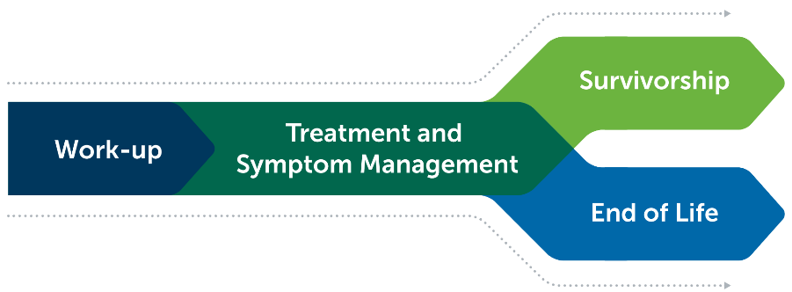
What do Via Pathways Cover?

Slide 22
What do Via Pathways Cover?

Slide 23
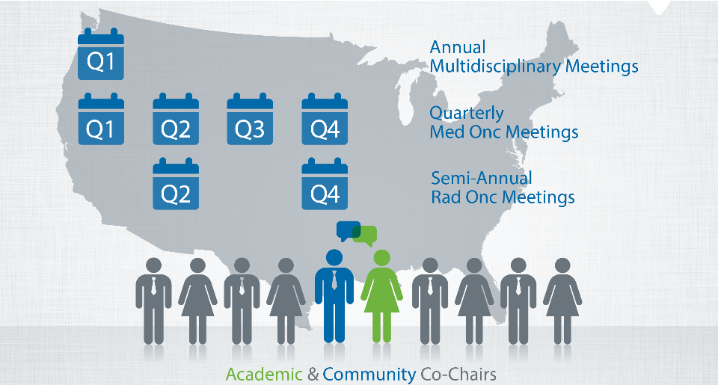
Who Develops the Via Pathways?
Committee Membership open to ALL Via Network Physicians

Slide 24
Committee Process
Disease Committee Participation open to all physicians and staff
“Signing Up” for specific committees will ensure communication of all agendas/minutes and Outlook invitation (communicate to Lauren Bradford)
Meeting schedule published for all of 2015
1 hour webinar/call at 5 pm Eastern time
CME Granted

Slide 25
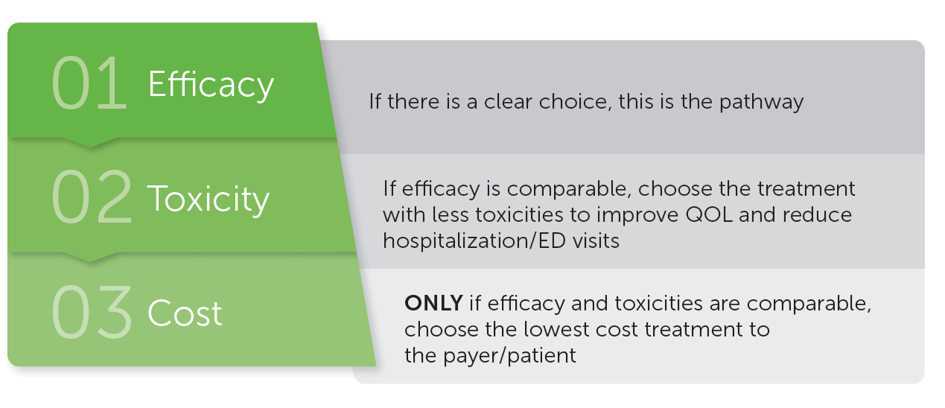
Pathway Determinants

Slide 26
Pathways Framework
Committees agree on Primary
“Single Best” Option
Plus
Committees add “Other Patient Scenarios” where needed – On Pathway
(e.g., poor performance status, can’t travel for weekly therapy, drug shortage, etc.)

Slide 27
On Pathway Rate Goal
Goal: 80%
But this is not a specific target…rather a broad goal to ensure that the Via Pathways can fit 80% of the patients within each disease
It’s ALWAYS ok to go Off Pathway…

Slide 28
Demonstration

Slide 29
Implementation

Slide 30
Customer Support
Account Manager (Lauren Bradford)
Implementation Project Manager (Nancy Wolper)
Fully staffed Help Desk
“Click Here for Support”
Issues
Committee Feedback

Slide 31
Physician Access
3 Ways to Provide Physicians with access to Via Pathways:
Hard copy of flowcharts
Look up with a link on their desktop (login) to Via Portal
Physicians chart on patient decision directly into the Via Portal

Slide 32
Reporting Demo (Tableau)

Slide 33
Questions?

